Slide 1



Slide 2


What’s new in AI?
Aicha OUADAH

Slide 3
Language models
Text to image generation

Slide 4
Language Models
PaLM
540 B
Megatron
530 B
Gopher
280 B
LaMDA
137 B
GLaM
97B

Slide 5
PaLM , LaMDA
LaMDA is a model focused on conversation and can power dialogue-based search and voice assistants and other dialogue applications.
PaLM is a model that follows what Google calls the Pathways AI architecture where a language model is trained to learn how to solve problems.

Slide 6
PaLM
Pathways Language Model
new AI architecture, Pathways.
Today's AI models are typically trained to do only one thing. Pathways will enable us to train a single model to do thousands or millions of things.

Slide 7
PaLM
Social media conversations (multilingual) 50%
Filtered web pages (multilingual)
Books (English)
GitHub (code) 5%
Wikipedia (multilingual) 4%
News (English) 1%

Slide 8
PaLM
It can solve complex math word problems, and answer questions in different languages
Improvement in Natural Language inference, common-sense reasoning, in context reading comprehension, question answering
The model can complete code, fix compilation errors, translate code from one language to other

Slide 9
LaMDA
Language Models for Dialog Applications
more natural ways of interacting with technology

Slide 10
LaMDA 2
Imagen it
Talk about it
List it

Slide 11
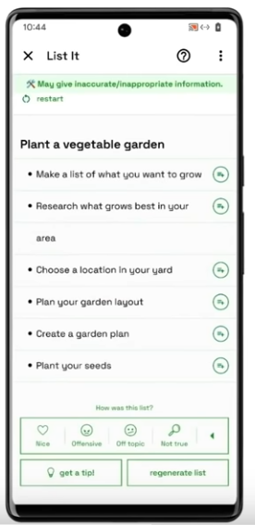
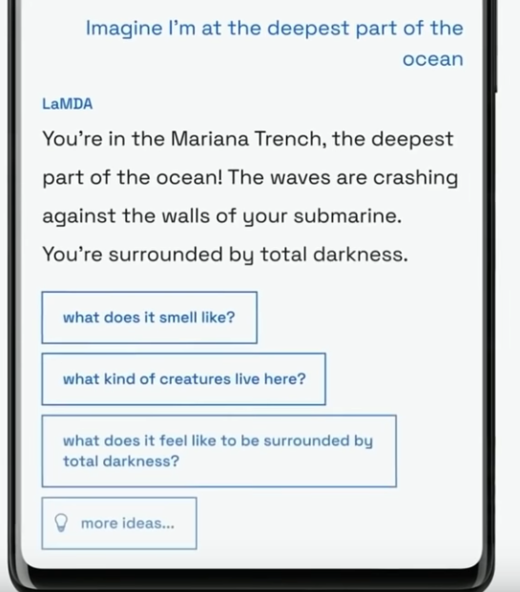

Slide 12
Text to image generation
DALL·E 2 (openai)
DALL·E Mini (hugging face)
Imagen (google)

Slide 13
DALL·E 2
is a new AI system that can create realistic images and art from a description in natural language.

Slide 14
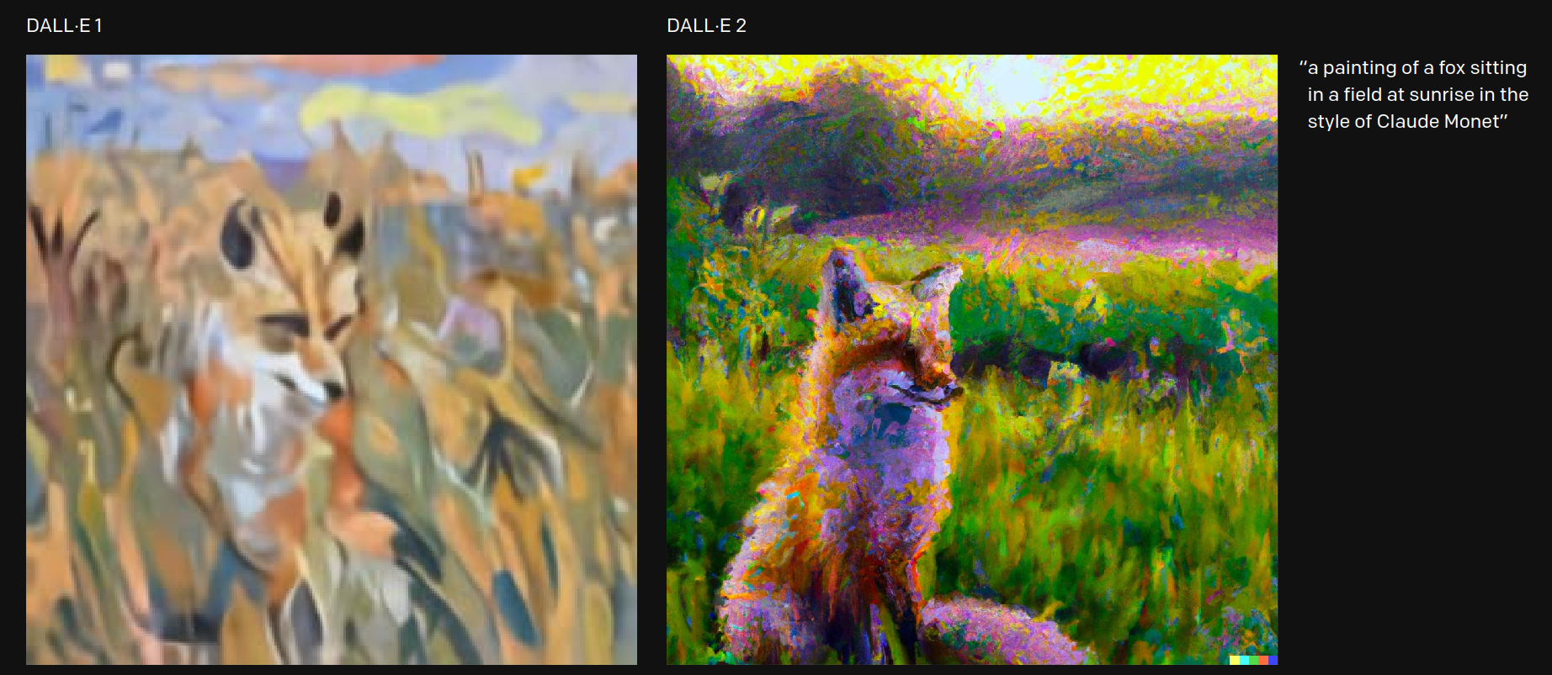
REPLACE PHOTO
DALL·E 1 vs DALL·E 2
caption matching and photorealism

Slide 15
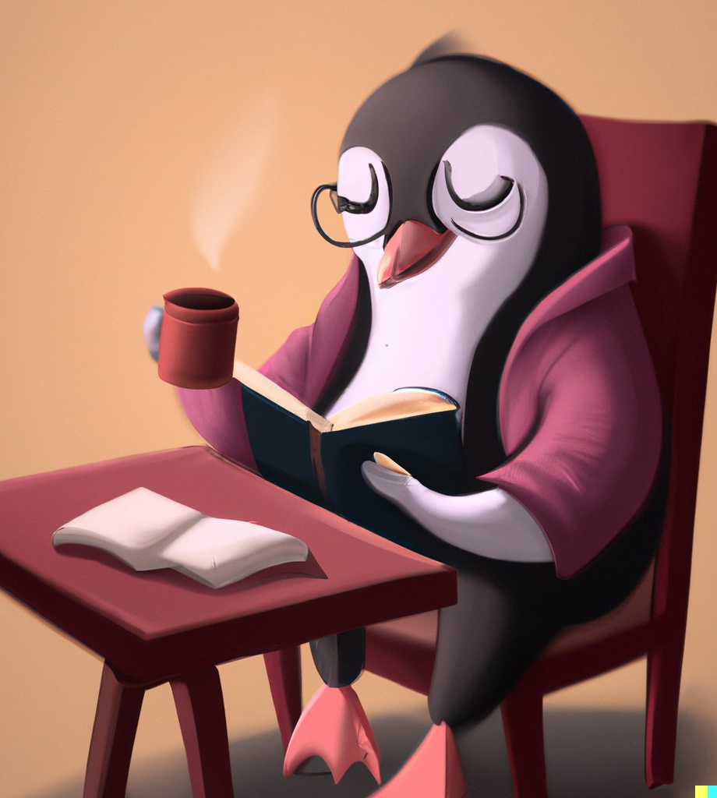
DALL·E 2 can
create original, realistic images and art from a text description. It can combine concepts, attributes, and styles.
Input : “A penguin reading a book peacefully while having coffee in the morning”

Slide 16
DALL·E 2 can
make realistic edits to existing images from a natural language caption. It can add and remove elements while taking shadows, reflections, and textures into account.

Slide 17
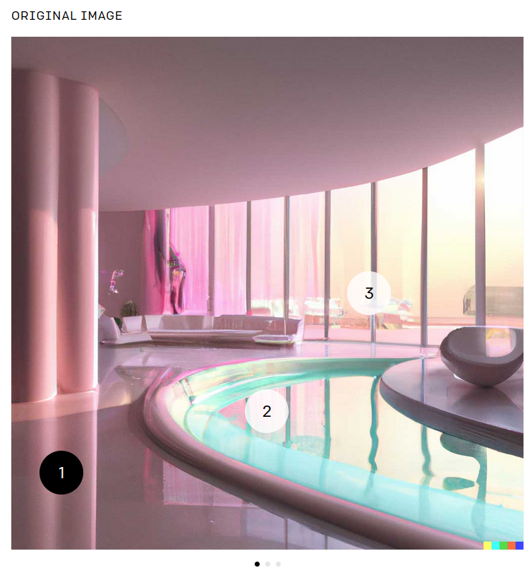
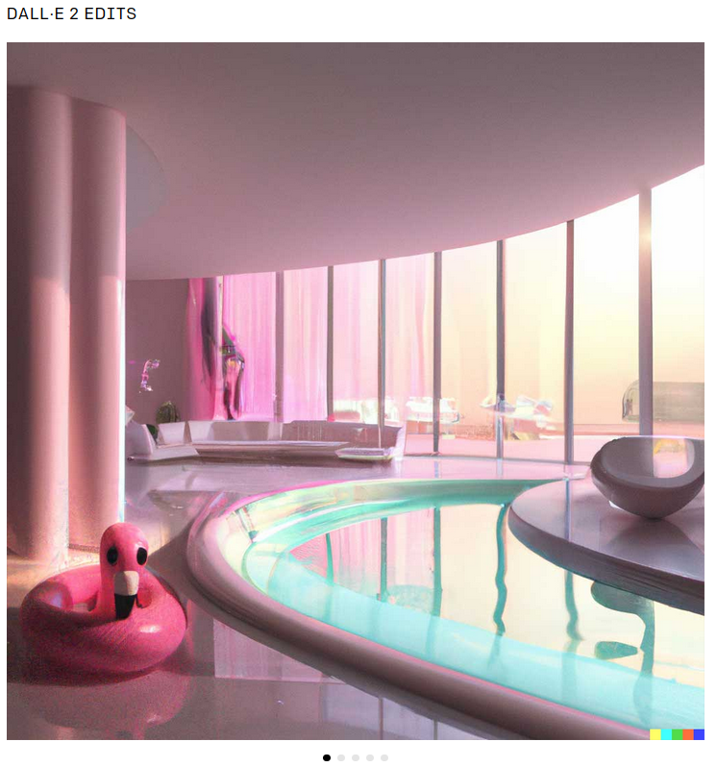

Slide 18
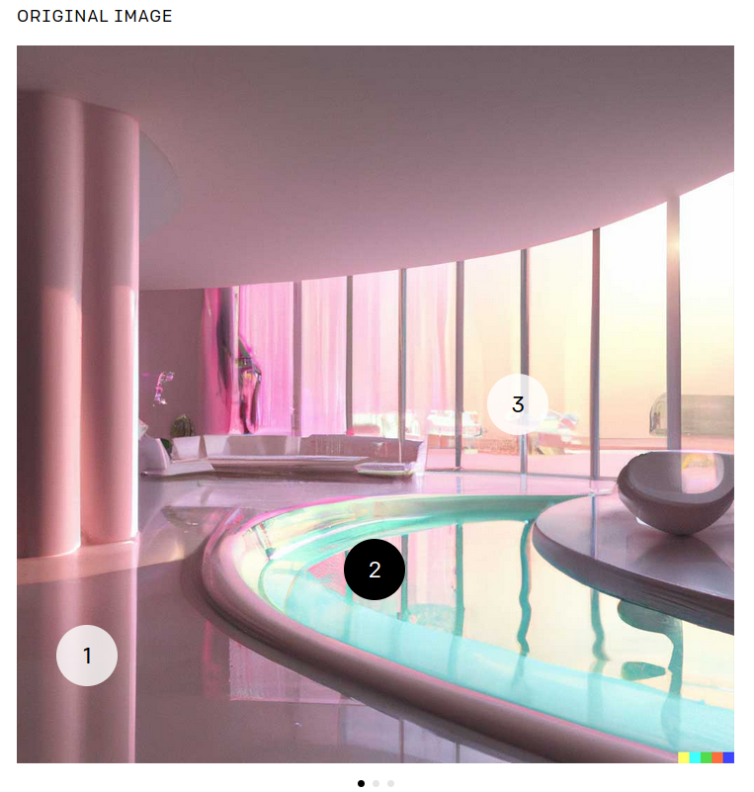
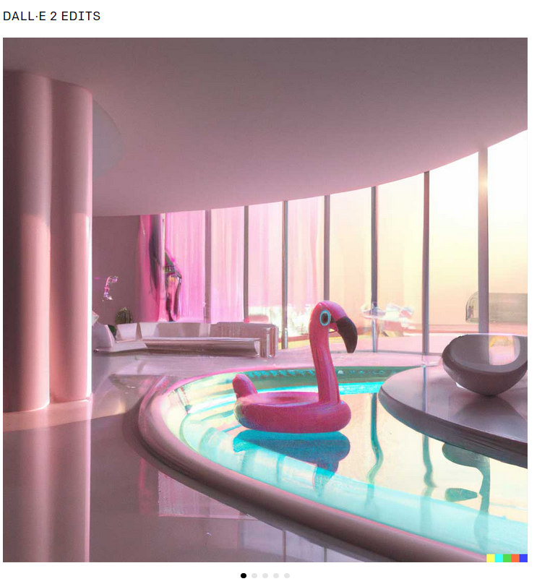

Slide 19
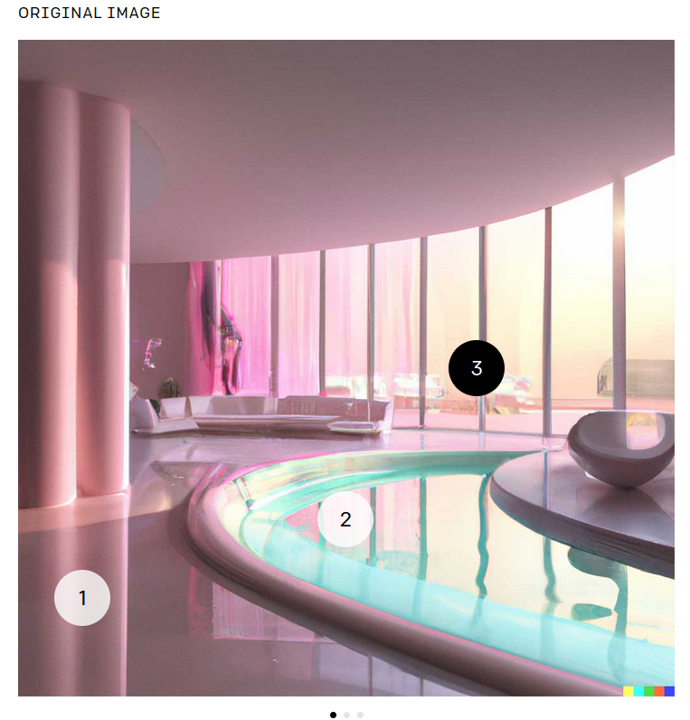
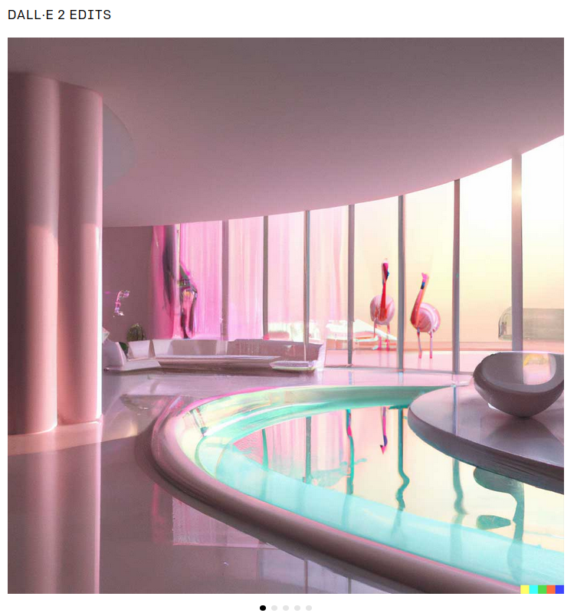

Slide 20
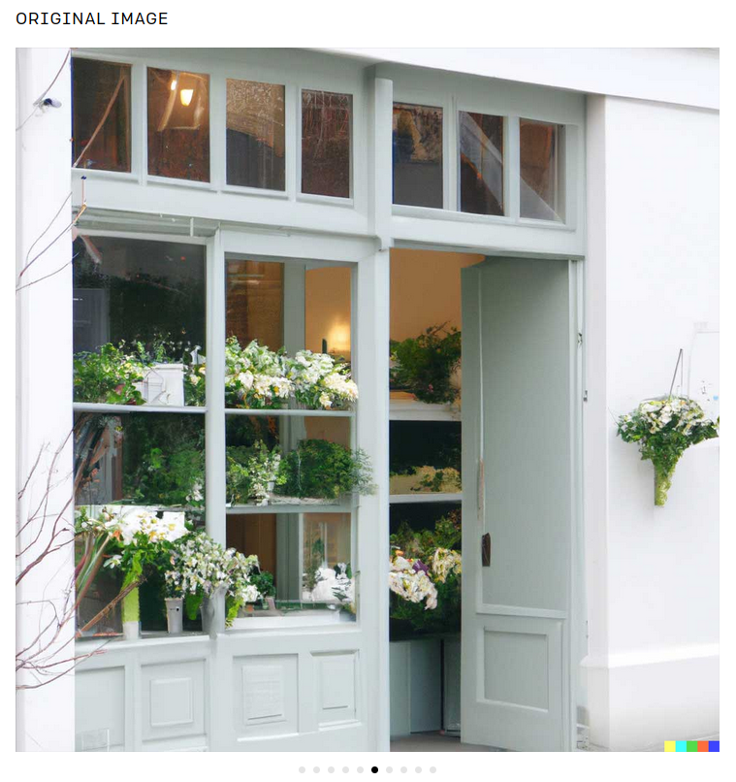
DALL·E 2 can
can take an image and create different variations of it inspired by the original.
Adobe Stock#243026154

Slide 21
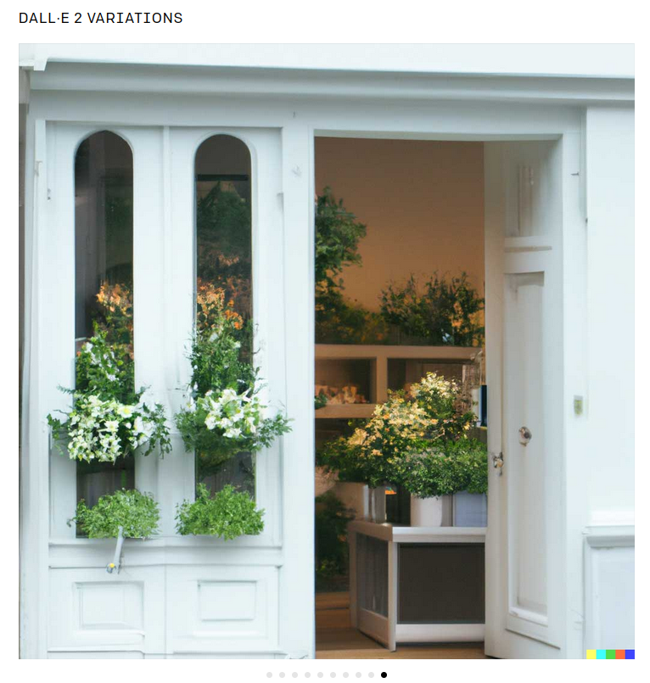
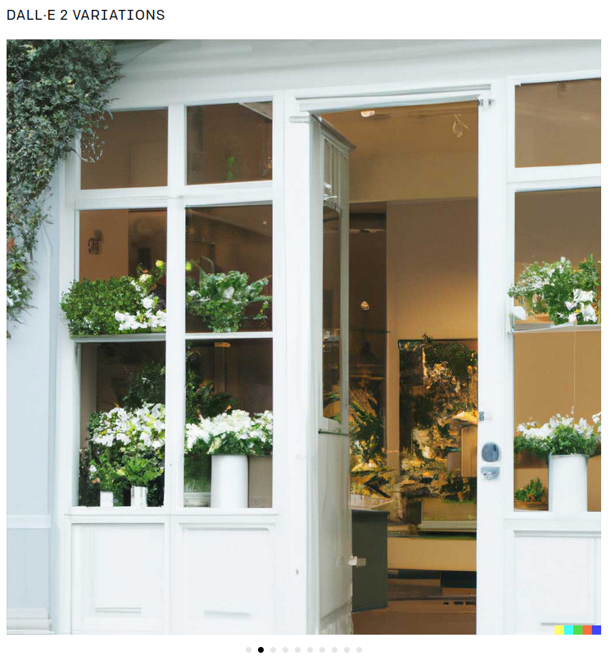
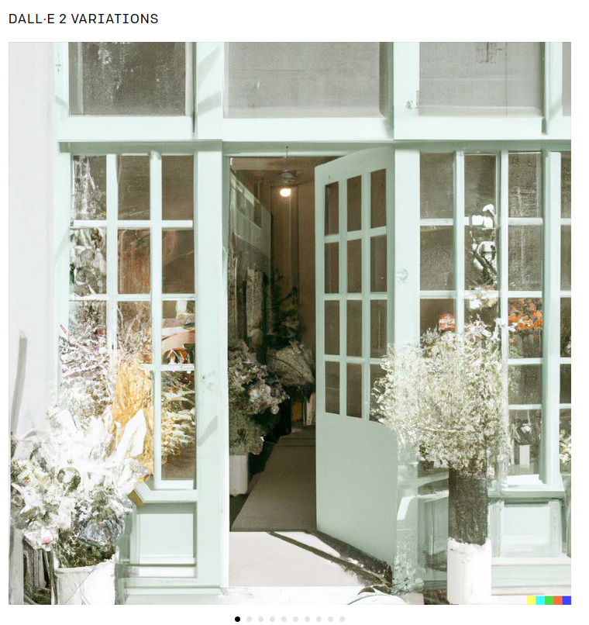

Slide 22
DALL·E 2 :
Diffusion Models are generative models, meaning that they are used to generate data similar to the data on which they are trained

Slide 23
DALL·E 2
Risks and limitations:
Adult content, illegal activities, violence, specific identities
text in images, long text input

Slide 24
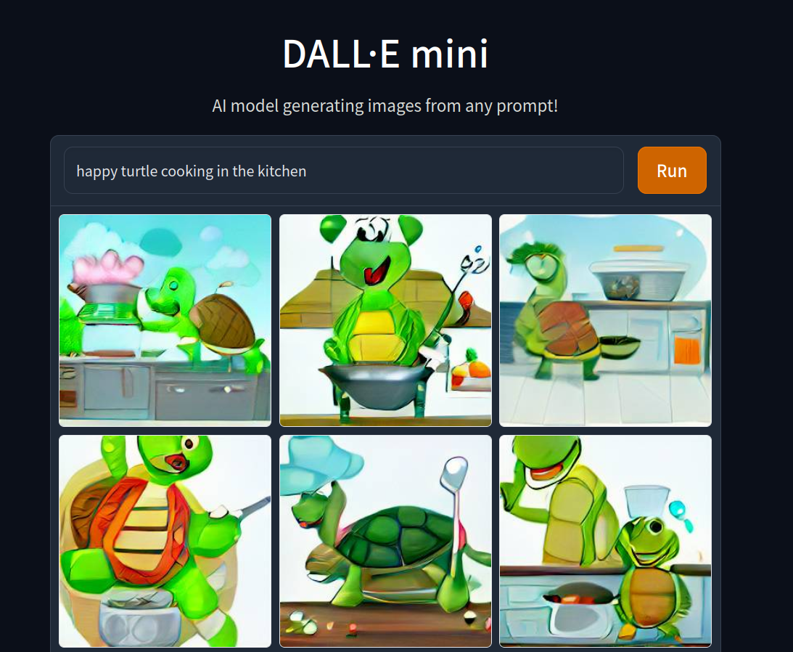
DALL·E Mini
Open source, public use.
Generate images from a text prompt.
Input : “happy turtle cooking in the kitchen”

Slide 25
DALL·E Mini
is trained with pairs : images and captions
it has 2 main components, language and image model
the language model (BART), transforms the text input in natural language to tokens readble by the next model (encoding)
the image model (VQGAN) is the decoder , it takes the BART output (encoding) and decode it to an image, then its output (generated image) is compared to the image input to adjust it.

Slide 26
Imagen
Is an AI system that creates photorealistic images from input text

Slide 27
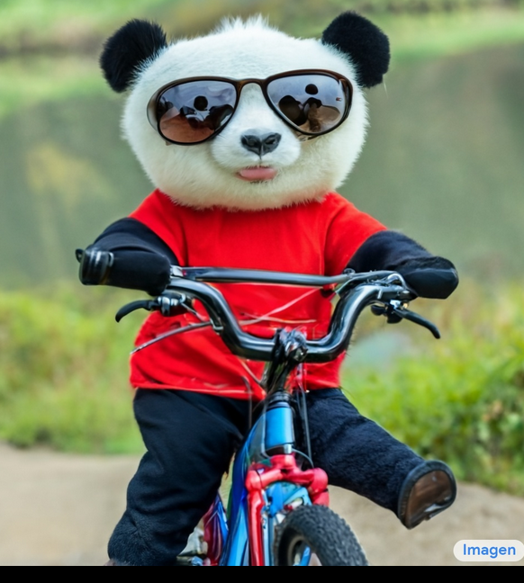
Imagen
Input : “a photo of a fuzzy panda wearing sunglasses and red shirt riding a bike on top of a mountain.”

Slide 28
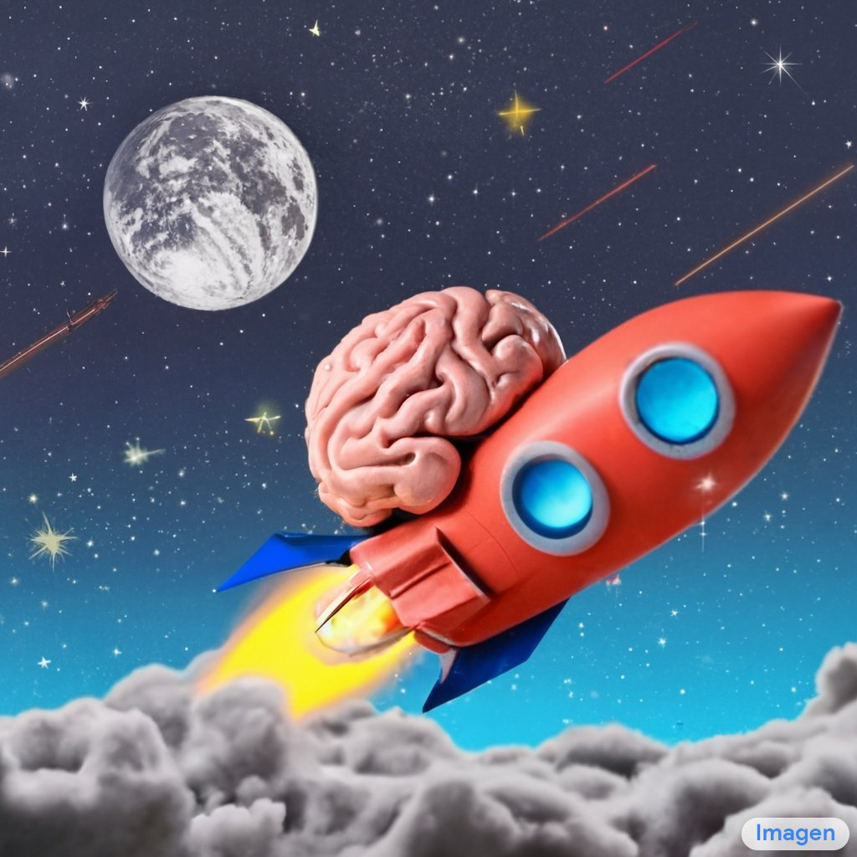
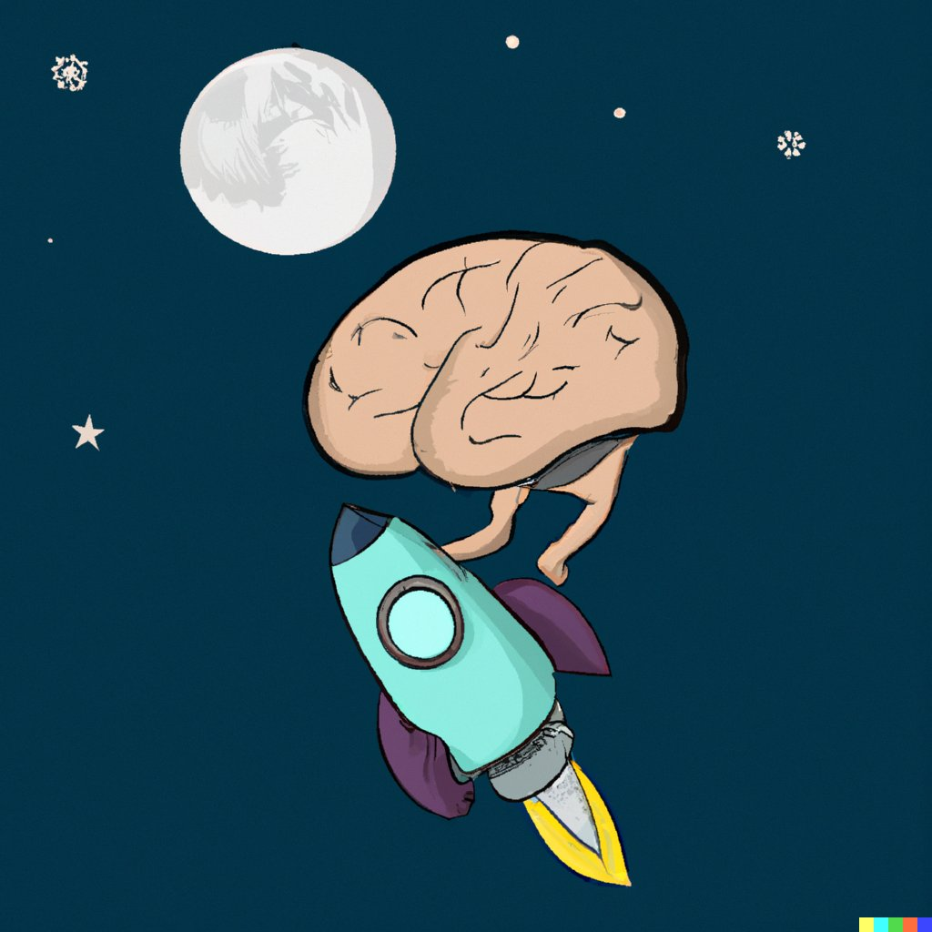
A brain riding a rocket ship heading towards the moon.
Imagen
DALL-E 2
source

Slide 29
WHY?
Imagen, DALL·E 1, Glide, DALL·E 2

Slide 30
Live Demo (DALL·E Mini)
Volunteer

Slide 31
“9ed ma tmed l GDG 9ed ma ymdlek .”
Redha Amirouche
Ex-GDG Algiers Lead

Slide 32
“Enjoy your journey with GDG.”
Keep doing cool things that matter

Slide 33


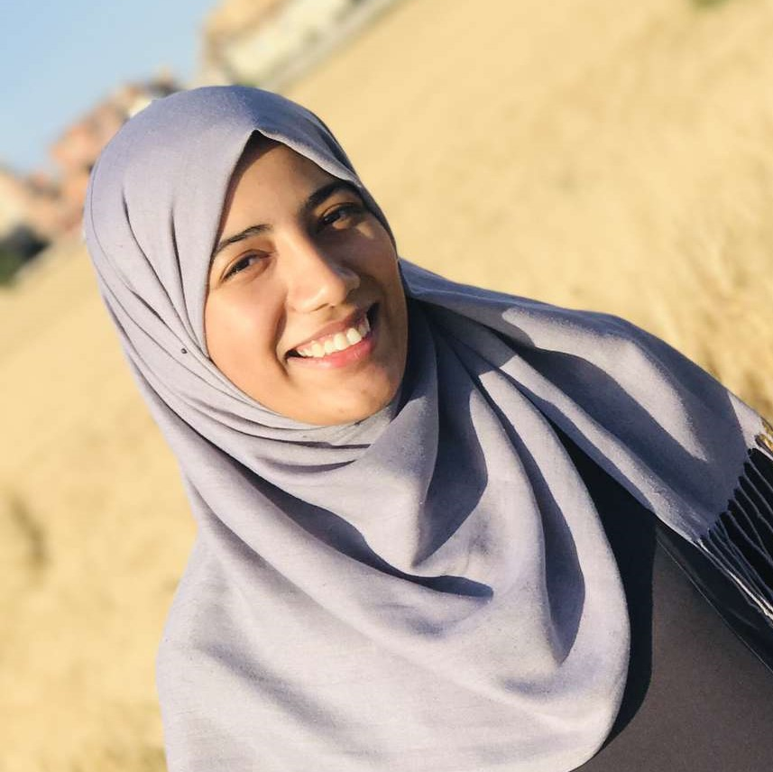


Resources
Thank you!
goo.gle/assistant-docs
https://openai.com/
AI Student @USTHB
Intern @LAMIH UPHF
@AichaOuadah
Aicha OUADAH
Resources
https://imagen.research.google/
https://ai.googleblog.com/
https://openai.com/
https://imagen.research.google/

